Slide 1

Intelligent Waste Separator
“Reuse then Recycle”

Slide 2
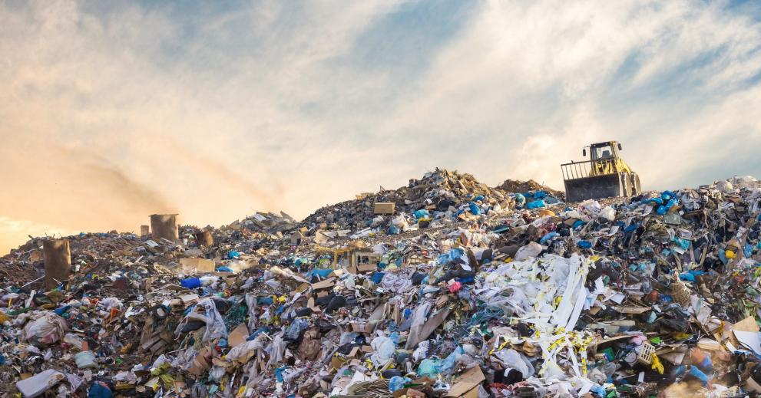
The Problem
Nowadays, trash has become a problem in the society and the ecosystem due to the way people get rid of it.
Most of garbage is buried or burnt or even kept in places to which it does not belong.
Big volumes of garbage thrown away and the methods used to store it cause air, water, and soil pollution

Slide 3
REUSE = Purest Form of Recycling
Fortunately, people can count on other methods to reduce the quantity of produced litter. An answer is recycling by re-using the materials.

Slide 4

REUSE = Purest Form of Recycling
Increasing recycling removes harmful products and materials from landfills
Conserves natural resources
Increases economic security by tapping a domestic source of materials
Prevents pollution
Saves energy
Reduces impact on climate change
Reduces risks in our industry
Good for the environment and our planet
Job Creation

Slide 5
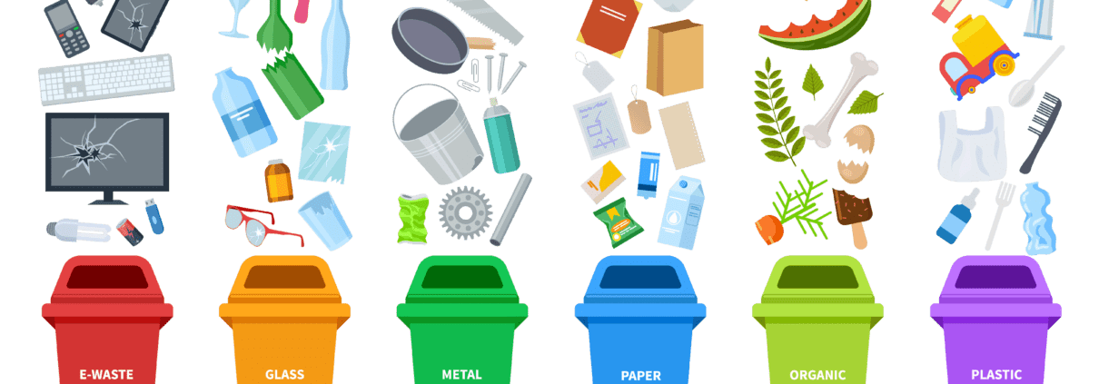
The plan
Currently, the traditional way to separate waste is to use different containers for each kind of waste separating trash manually, which does not always work. The aim of this paper is to present an Intelligent Waste Separator (IWS)
With the aid of technology this problem can be solved.
We are a group of students from SCE college for engineering , designed an autonomous recycling garbage can, which can separate objects made of plastic, glass, or aluminum. It classifies waste using a barcode scanner.

Slide 6
Competition
Another way of separating waste is by making an indirect sorting process using an optical sensor, which detects the particles’ sizes and positions, colors and shapes, and a mechanical separating system consisting of compressed air controlled by a computer in contrast to the traditional magnetic sorting technology which separates only ferrous and nonferrous metals.
This method can be used to separate large quantities of trash at the industrial level.

Slide 7
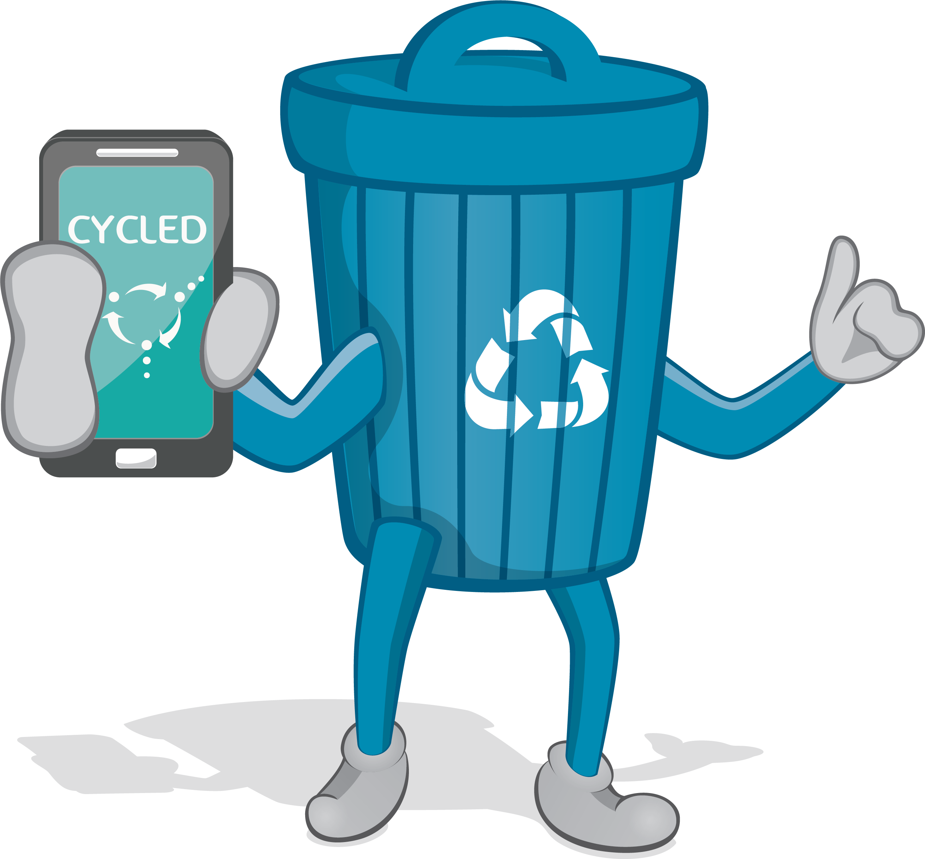
Our take
We are proposing a prototype of an Intelligent Waste Separator (IWS) that consists of a common trash can, with more containers inside it, using multimedia technology.
It can be used anywhere and with a fun engaging way make the consumer part of the sorting process.
And by doing so help grow awareness about recycling.
People can throw their waste, no matter what kind into the system.
The recycling bin will be able to determine what kind of waste it is and to deposit it in the correct container.

Slide 8

Current Goals and Objectives
The main requirements of the mechanical prototype are low cost, strong material, and a simple design so it may be placed almost anywhere, for example, in public areas where RVMs or ATMs could be located.
The design involves the following features: a stable structure, not bulky, can be armed, disarmed, and stored, high quality materials, low cost but efficient mechanisms, and an easy manufacture design

Slide 9
The Team Organization Chart
Ella Bokova
Project Supervisor
Hardware R&D Team
Software R&D Team
Nadav
Machine Engineer
Maor Arnon
Software Engineer
Yovel
Software Engineer

Slide 10

The Team
This passion project is orchestrated and backed up by our project supervisor Ella Bokova.
Designed and developed by the team of three 3rd year engineering students from SCE college.
Nadav as our hardware developer and our product designer.
Maor and Yovel as our programmers and software designers.
Together, we were able to build a unified and cohesent product that can benefit the environment.

Slide 11
Thank You For Listening!

